Slide 1
#05 Windows Control, Events and Event Handlers
Notes:
Give an explanation for windows control, events and event handlers
Relevant theoretical decisions
What are windows controls?
What is an event and what does it mean?
What is an event handler, how it works and what it contains?

Slide 2
Class

Slide 3
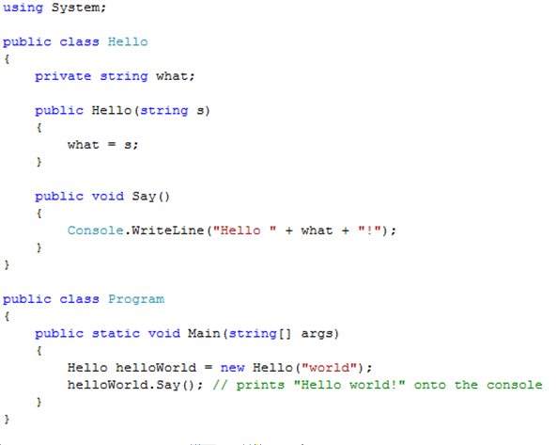
Class Example and Visibility

Slide 4

Interfaces
“An interface is a contract that guarantees to a client how a class will behave”
A Class can implement more the one interface
Interfaces can be extended and combined

Slide 5
Abstract Class

Slide 6
Abstract Class Vs Interface

Slide 7
Garbage Collector
C# performs automatic garbage collection
Collection/removing objects that are marked as garbage
Object that no longer has a reference
C# programmers don’t need to worry about explicitly reclaiming memory that has become garbage

Slide 8
Use in our program

Slide 9
Use in our program

